Slide 1

Puducherry Technological University
Department of Electronics and Communication Engineering
HYBRID CRYPTOGRAPHIC ALGORITHM FOR
IOT NODES
EC232 – PROJECT WORK
Guided By:
Dr.Gnanou Florence Sudha
Professor
Department of ECE, PTU
Presented by:
Anuragaa S
Thirumurugan S
Parimaladevi T
Mohamed Noorul Hak K
20EC1083
20EC1082
20EC2004
20EC2003

Slide 2
AGENDA
Objective
Literature Survey
Existing System
Proposed Solution
Block Diagram
Flow Diagram
Requirements
Connections
Work done till now
Code Snippets
Outputs
Advantages
Conclusion
References

Slide 3
OBJECTIVE
To design an Hybrid cryptography algorithm to achieve confidentiality and increased security in IoT environment, with maximum efficiency and limited resource constraints.

Slide 4
LITERATURE SURVEY
S.NO | TITLE & AUTHOR | JOURNAL NAME & YEAR | TECHNIQUE PROPOSED | LIMITATIONS
1. | Dr.M.Tanooj kumar, Revanth Kumar Katragadda, Vishnu Srujan Kolli and Shaik Lahir Rahiman | “A Hybrid Approach for Enhancing Security In Internet of Things (IoT)”,in International Conference on Intelligent Sustainable Systems (ICISS), 2019, | Hybrid encryption using AES and Rail Fence cipher | Because of its limited key space and susceptibility to known-plaintext attacks, the Rail Fence Cipher is vulnerable to brute-force attacks.
2. | Nilupulee A. Gunathilake, William J. Buchanan and Rameez Asif | ”Next Generation Lightweight Cryptography for Smart IoT Devices”, in IEEE 5th World Forum on Internet of Things (WF-IoT), 2019. | Various light weight cryptographic solutions | Various light weight cryptographic algorithms and their limitations were discussed

Slide 5
LITERATURE SURVEY
S.NO | TITLE & AUTHOR | JOURNAL NAME & YEAR | TECHNIQUE PROPOSED | LIMITATIONS
3. | Meryam Saad Fadhil, Alaa Kadhim Farhan, Mohammed Natiq Fadhil, Nadia M. G. Al-Saidi | “A New Lightweight AES using a Combination of Chaotic Systems”, on 1st International Conference on Information Technology to enhance E-learning and other Application, (IT-ELA), 2020. | AES encryption using Chaotic Systems | Chaotic encryption algorithms uses floating point calculations which makes the practical software or hardware implementation complex and inefficient.
4. | Mohammed Aledhari, Ali Dehghantanha, Kim-Kwang Raymond Choo | ”A Hybrid RSA algorithm in support of IoT Greenhouse Applications”, on IEEE International conference on Industrial Internet (ICII), 2019. | Hybrid RSA algorithm for IoT devices | RSA algorithm uses large key lengths. So, it is not suitable for resource constrained networks.

Slide 6
LITERATURE SURVEY
S.NO | TITLE & AUTHOR | JOURNAL NAME & YEAR | TECHNIQUE PROPOSED | LIMITATIONS
5. | B. T. Asare, K. Quist-Aphetsi and L. Nana | "A Hybrid Lightweight Cryptographic Scheme For Securing Node Data Based On The Feistel Cipher And MD5 Hash Algorithm In A Local IoT Network" 2019 International Conference on Mechatronics, Remote Sensing, Information Systems and Industrial Information Technologies (ICMRSISIIT, 2019. | A Hybrid approach using Fiestal cipher and MD5 Hash algorithm for IoT network | DES algorithm uses the Fiestal structure, which can easily be cracked by using Brute Force Attacks
6. | A. Raya and k. Mariyappn | ”Security and Performance of Elliptic Curve Cryptography in Resource-limited Environments A comparative Study”,on 15th International Conference on Internet Technology and Secured Transactions (ICITST), 2020. | Study of Elliptic Curve Cryptography for Resource Constrained Devices | ECC offers advantages like Key management and Digital Signatures, But, it is not directly used for Encryption

Slide 7
LITERATURE SURVEY
S.NO | TITLE & AUTHOR | JOURNAL NAME & YEAR | TECHNIQUE PROPOSED | LIMITATIONS
7. | J. Kaur, S. Lamba and P. Saini | "Advanced Encryption Standard: Attacks and Current Research Trends“, 2021 International Conference on Advance Computing and Innovative Technologies in Engineering (ICACITE), 2021. | Study of Advanced Encryption Standards and its security threats | AES has a disadvantage of managing and securely communicating the keys
8. | J. Zhao | A Hybrid Encryption Algorithm Based on DES and RSA" 2023 IEEE 3rd International Conference on Power, Electronics and Computer Applications (ICPECA), 2023. | A Hybrid algorithm using Data Encryption Standard (DES) and RSA algorithm | DES is susceptible to Brute Force Attack and RSA has a disadvantage of larger key sizes

Slide 8
EXISTING SYSTEM
Existing IoT security solutions are often ill-suited for resource-constrained devices due to compatibility issues.
Existing systems mostly use RSA algorithm as their asymmetric encryption scheme, which uses a key size of 3072 bit, which is not suitable for resource constrained devices.

Slide 9
PROPOSED SOLUTION
The proposed system uses a Hybrid Cryptographic algorithm, which is a combination of AES (Advanced Encryption Standard) and ECC
(Elliptic Curve Cryptography).
AES serves as the primary encryption algorithm, providing elevated security standards.
ECC is used for the key generation for the subsequent AES encryption.

Slide 10
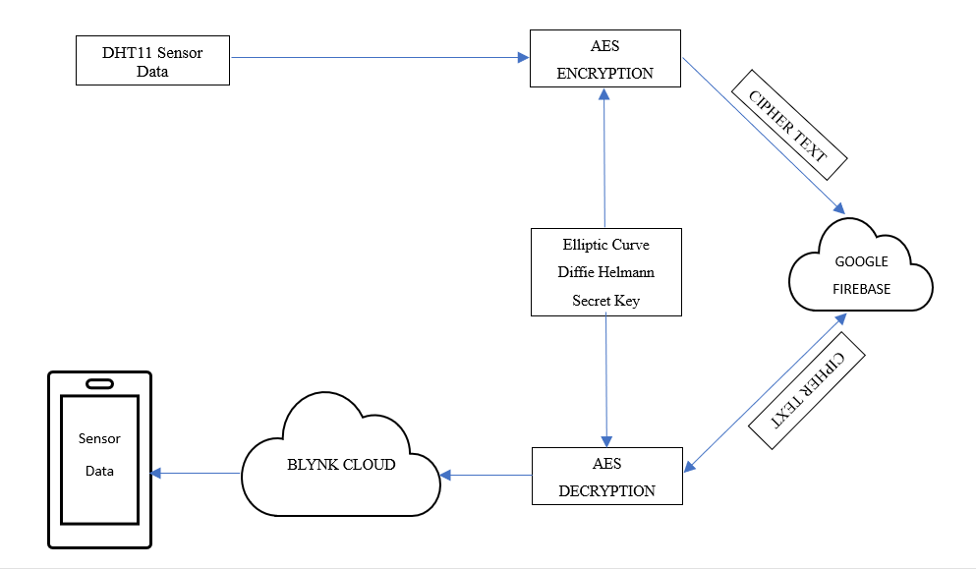
BLOCK DIAGRAM

Slide 11
FLOW DIAGRAM
FOR AES

Slide 12
Plain Text
Plain Text
Convert from String into Bytes
Convert from Bytes into String
Create an instance for the AES class
cipher = aes(key, 2, iv)
Call the decrypt function decipher.decrypt(ciphertext)
Divide Plaintext into Blocks of Size 16
Create an instance for the AES class
decipher = aes(key, 2, iv)
Initialization vector
Call the encrypt function cipher.encrypt(plaintext)
Elliptic Curve
Diffie Helmann
Secret Key
Convert from Bytes into String
Convert from String into Bytes
Append the IV with the encrypted data
Separate the IV from the Ciphertext
Initialization vector
Cipher Text
Cipher Text

Slide 13
FLOW DIAGRAM
FOR ECC

Slide 14
Create an instance for the class get_curve
“curve = reg.get_curve(‘secp192r1’)”
Public key retrieved from the Google Firebase
Split into 2 co-ordinates x and y
Choose the Private key from the curve
Convert from String into Bytes
Convert from String into Bytes
X
Convert it into a point on the curve
ECC Private Key generation
ECC Public Key generation
Shared Secret Key
Convert from Bytes to String
Split the first 32 characters
Elliptic Curve
Diffie Helmann
Secret Key

Slide 15
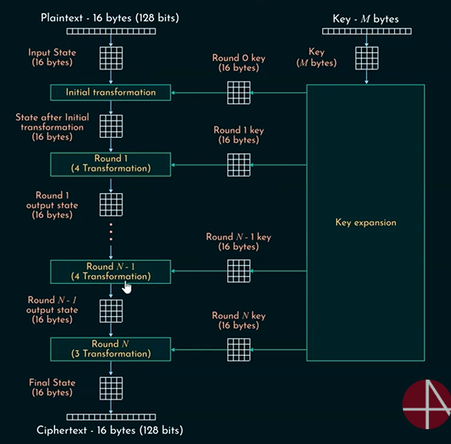
AES
The number of rounds in AES depends on the size of the Round key.
For 128 bit key, 10 rounds
For 192 bit key, 12 rounds
For 256 bit key, 14 rounds
Each round has 4 stages in it.
Substitute bytes
Shift rows
Mix columns
Add round key
The last round only has 3 rounds excluding the Mix columns stage.
Existing systems mostly use RSA algorithm as their asymmetric encryption scheme, which uses a key size of 3072 bit, which is not suitable for resource constrained devices.

Slide 16
AES
We are using the built-in “ucryptolib” library for the AES encryption.
We can import the library using the command
“from ucryptolib import aes”
To create an instance for above AES class, we can use the command
“cipher = aes(key, 2, iv)”
The above parameters refer to encryption key, mode of operation, and initialization vector.
“2”: This parameter represents the AES mode of operation.
The encryption is done by the function
“ciphertext = cipher.encrypt(plaintext)”
The decryption is done by the function
“decrypted_text = decipher.decrypt(ciphertext)”

Slide 17
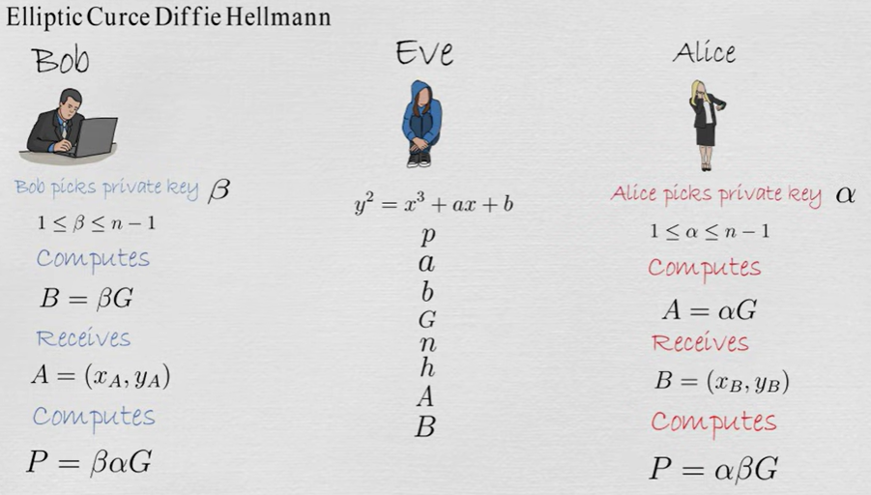
ELLIPTIC CURVE DIFFIE HELMANN
Elliptic-curve Diffie–Hellman (ECDH) is a key agreement protocol that allows two parties, each having an elliptic-curve public–private key pair, to establish a shared secret over an insecure channel.

Slide 18
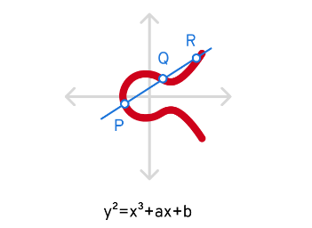
ELLIPTIC CURVE CRYPTOGRAPHY
Private Key Generation: A random number, usually denoted as ‘d’, is selected from a range determined by the order of the elliptic curve’s cyclic group.
Public Key Derivation: The public key is generated by scalar multiplication of the elliptic curve’s base point (a predefined point) with the private key.
We are using the “TinyEC” library, which is a lightweight library that provides support for elliptic curve cryptography (ECC).

Slide 19
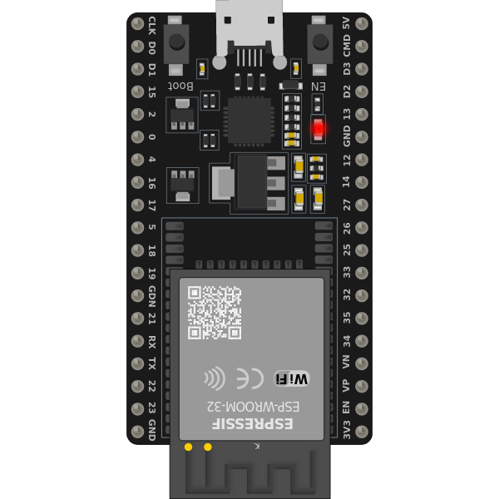
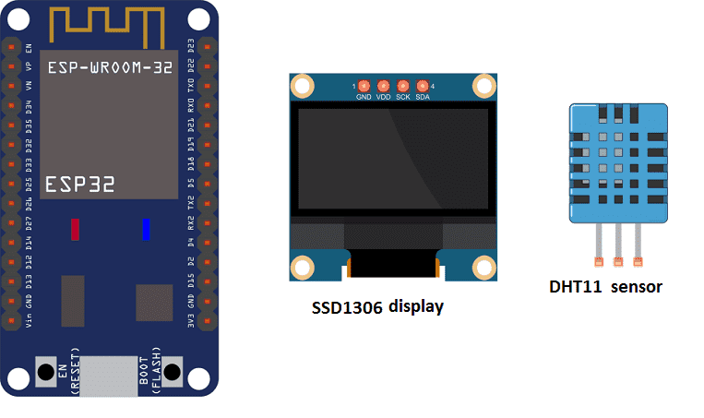
REQUIREMENTS
HARDWARE
Microcontroller (ESP32)
DHT11 - Temperature and Humidity Sensor
OLED display
Jumper wires
Breadboard

Slide 20


REQUIREMENTS
SOFTWARE
Thonny IDE
Blynk IOT platform
TECHNICAL STACK
Google Firebase
Twilio Communication API

Slide 21
SOFTWARES AND TECHNICAL STACK
Google Firebase : The Firebase Realtime Database is a cloud-hosted NoSQL database that lets you store and sync data between your users in realtime.
Blynk IOT platform : Blynk is an IoT platform for iOS or Android smartphones that is used to control Arduino, Raspberry Pi and NodeMCU via the Internet.
Twilio communication API : Using Twilio's Programmable SMS , you can quickly integrate text messaging capabilities (sending and receiving) into your web, mobile, or desktop application.

Slide 22
PYTHON vs MICROPYTHON
Feature | Python | MicroPython
Language Syntax | Standard Python syntax | Subset of Python syntax
Memory Usage | Generally higher due to full standard library | Designed for resource-constrained devices
Platforms | Runs on desktops, servers, and embedded systems | Primarily targeted at microcontrollers
Development | Larger community, more third-party libraries | Smaller community, focused on embedded systems
Use Cases | Web development, data analysis, automation | IoT, embedded systems, sensor networks

Slide 23
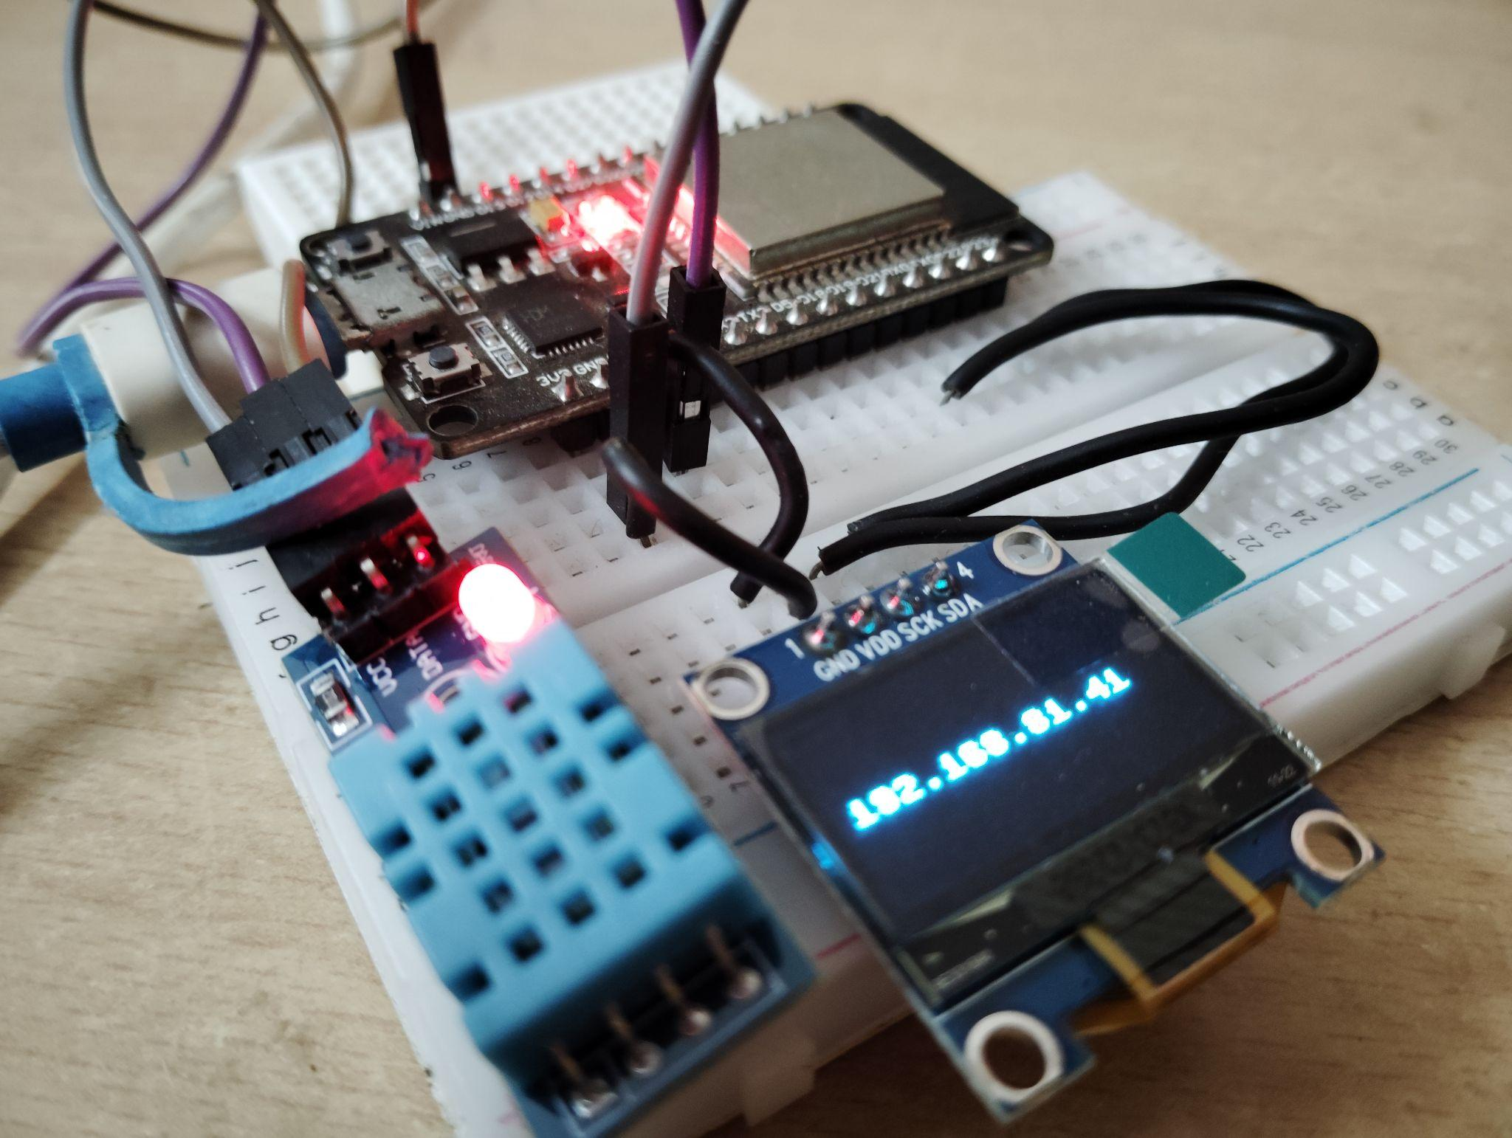
CONNECTIONS
DHT11 (Temperature and Humidity sensor) is connected to the D15 pin of the ESP32 module.
The SCK and SDA pins of OLED display is connected to pins D22 and D21 of the ESP32 modules respectively.

Slide 24
WORKS DONE
Study of Advanced Encryption Standard (AES) algorithms.
Study of Elliptic Curve Cryptography (ECC) and its role in secure key exchange.
Implementation of AES using ucryptolib library in Micropython.
Implementation of ECC using TinyEC library in Micropython.
The shared secret key is generated using the Private key of the sender and Public key of the receiver.
Integration of both the algorithms (AES encryption and decryption using the Secret key generated by ECC).
The algorithms were implemented in a ESP32 Microcontroller, which is most suitable for IoT environments.

Slide 25
WORKS DONE
A DHT11 sensor measures the Temperature and Humidity data and the data is encrypted using our proposed Hybrid algorithm.
The encrypted sensor data is stored within Google Firebase and subsequently accessed by the receiver.
The decrypted data is then transmitted to the Blynk cloud and displayed for the recipient.
We have analyzed the constraints on resources, including storage, power consumption, time delay, and security.

Slide 26
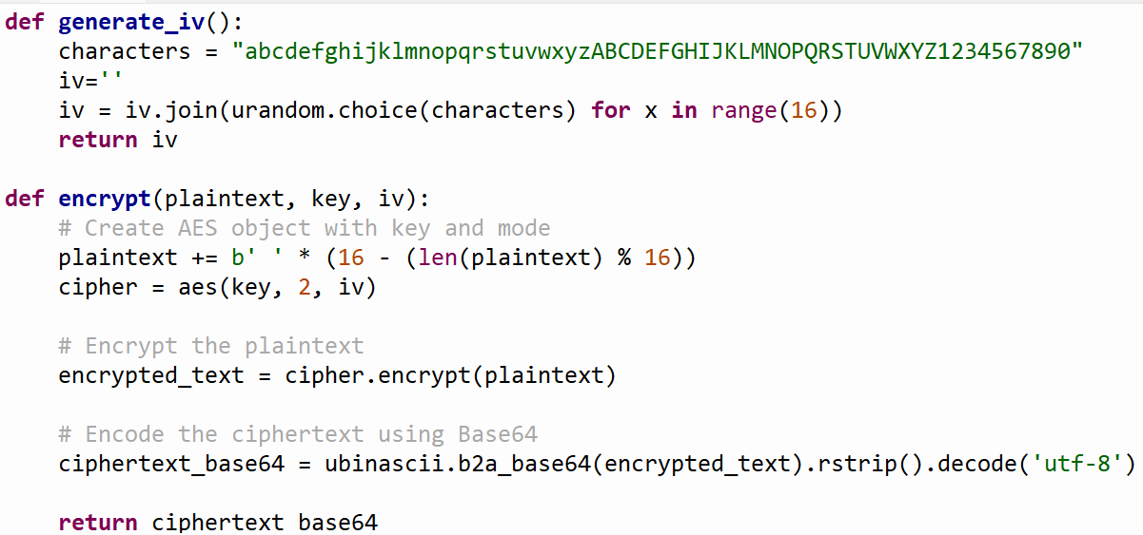
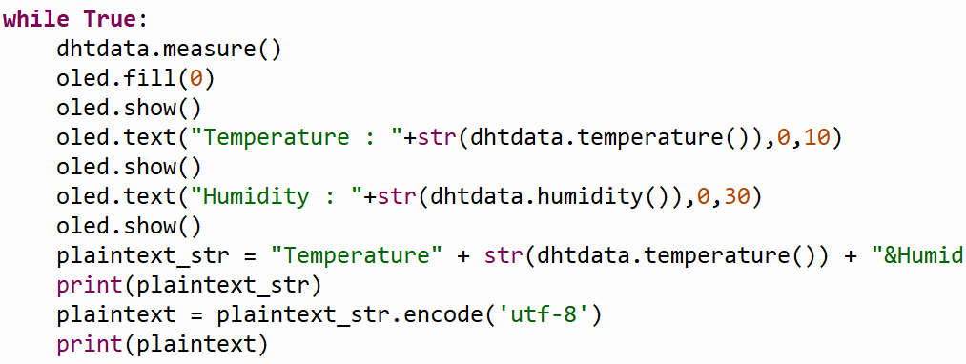
CODE SNIPPETS
Functions for generating a random Initialization vector and encrypting the data using AES Encryption with UCRYPTOLIB library
Sensing the Temperature and Humidity data from the DHT11 sensor and displaying it in the OLED display

Slide 27
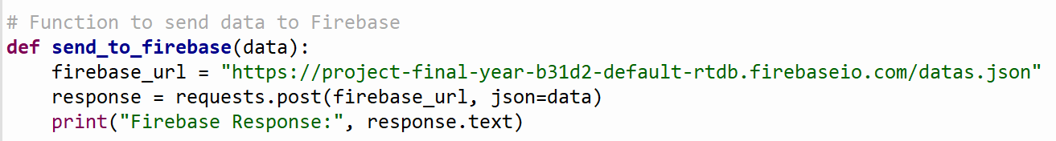
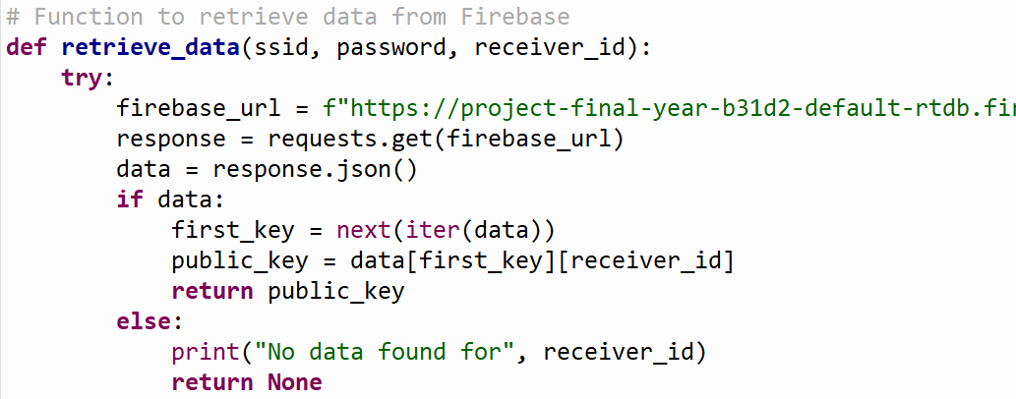
CODE SNIPPETS
Storing the encrypted data to the FIREBASE
Retrieving the Public key from the FIREBASE

Slide 28
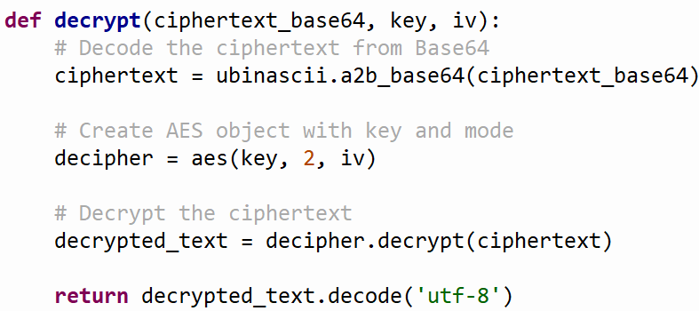
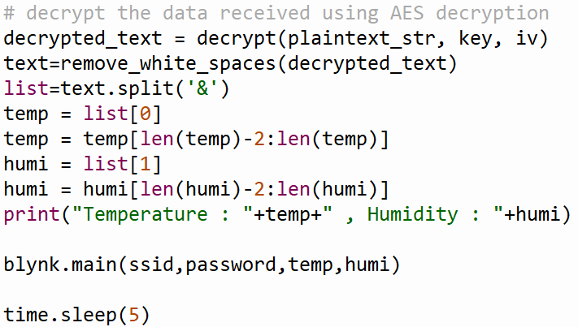
CODE SNIPPETS
Function for decryption using AES decryption with
UCRYPTOLIB library
Sending the Temperature and Humidity data to BLYNK SERVER

Slide 29
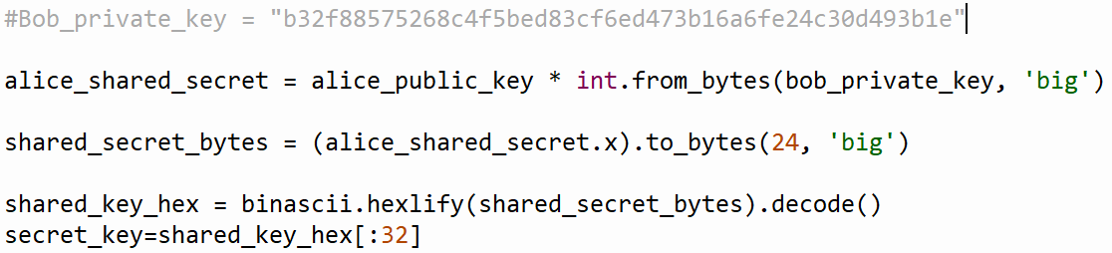
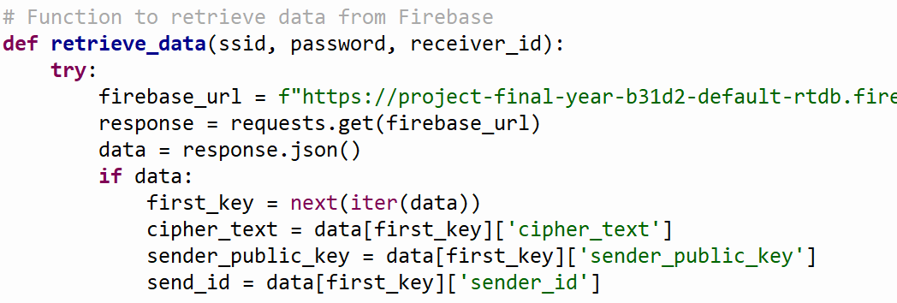
CODE SNIPPETS
Multiplying the Public key and Private key to get the ECC Shared Secret Key
Retrieving the necessary data from the FIREBASE

Slide 30
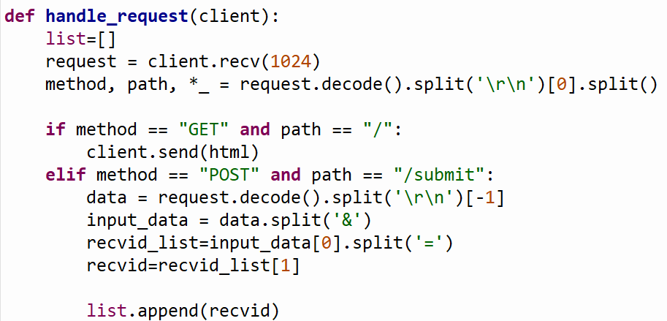
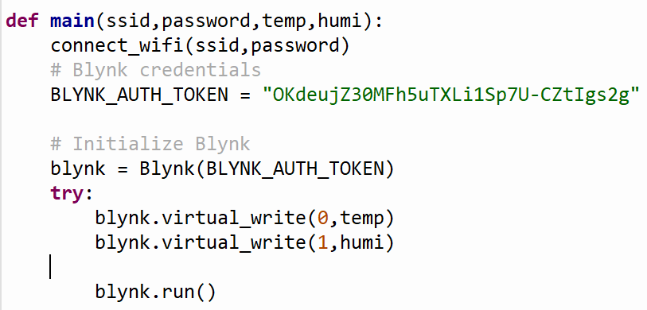
CODE SNIPPETS
Getting inputs via an HTML web page
Storing the Temperature and Humidity data in virtual pins 0 and 1 on the BLYNK IOT application

Slide 31
SAMPLE INPUTS AND OUTPUTS SENDER SIDE

Slide 32
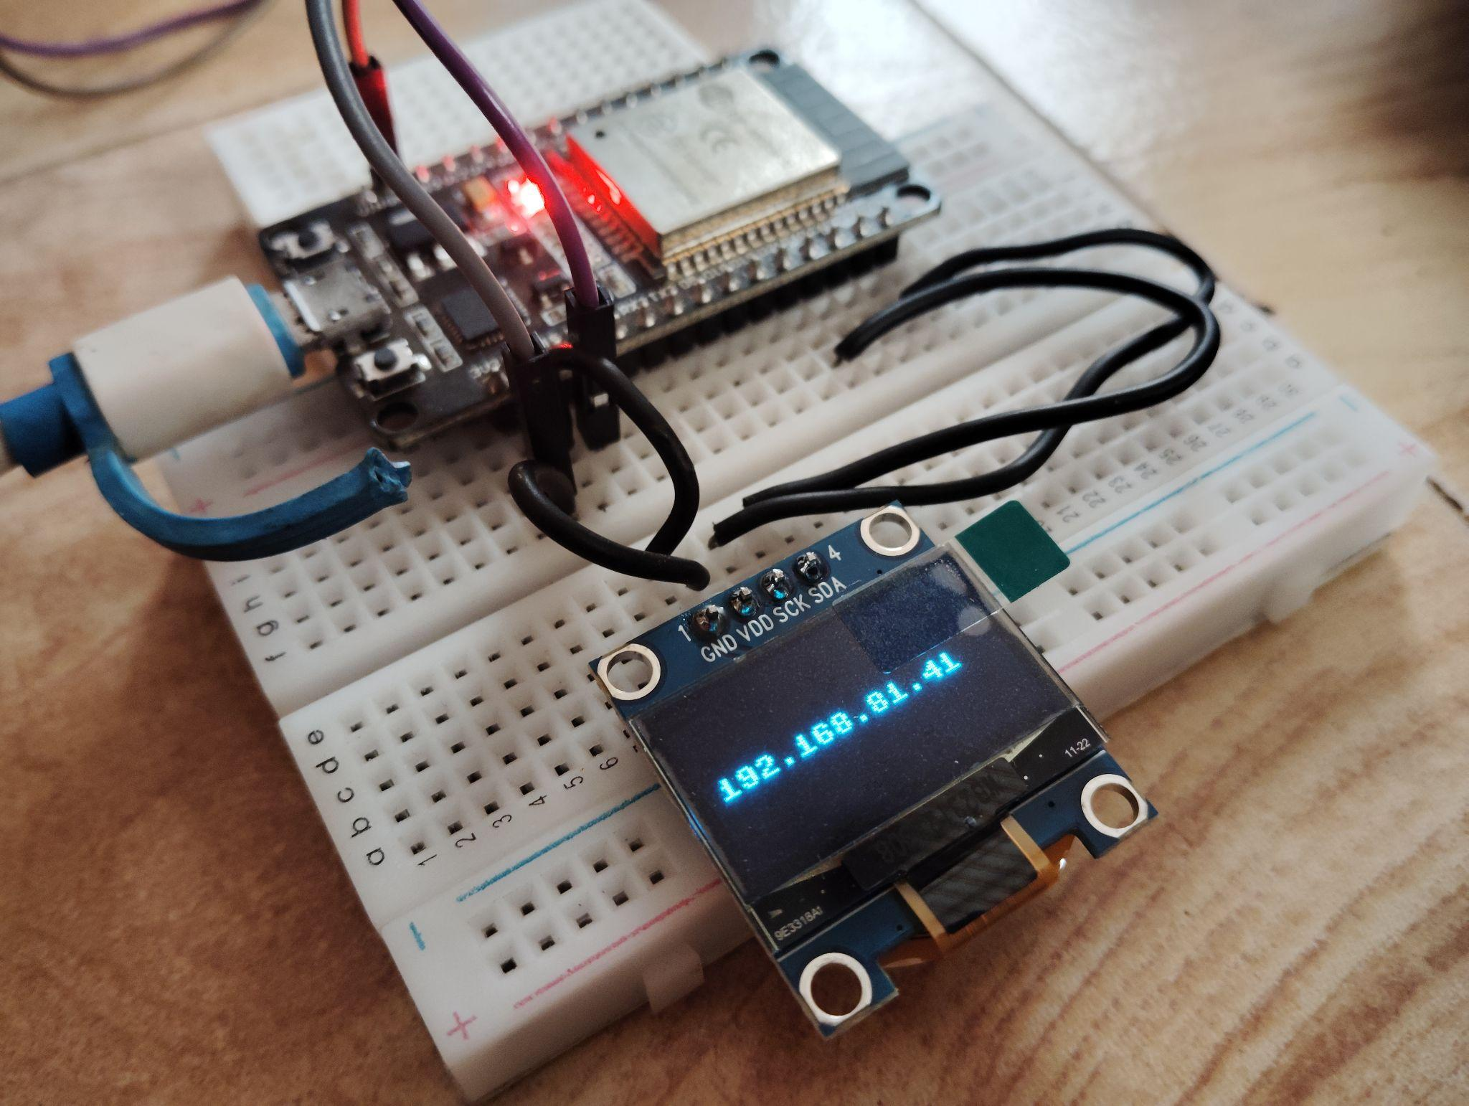
IP ADDRESS ON OLED DISPLAY

Slide 33
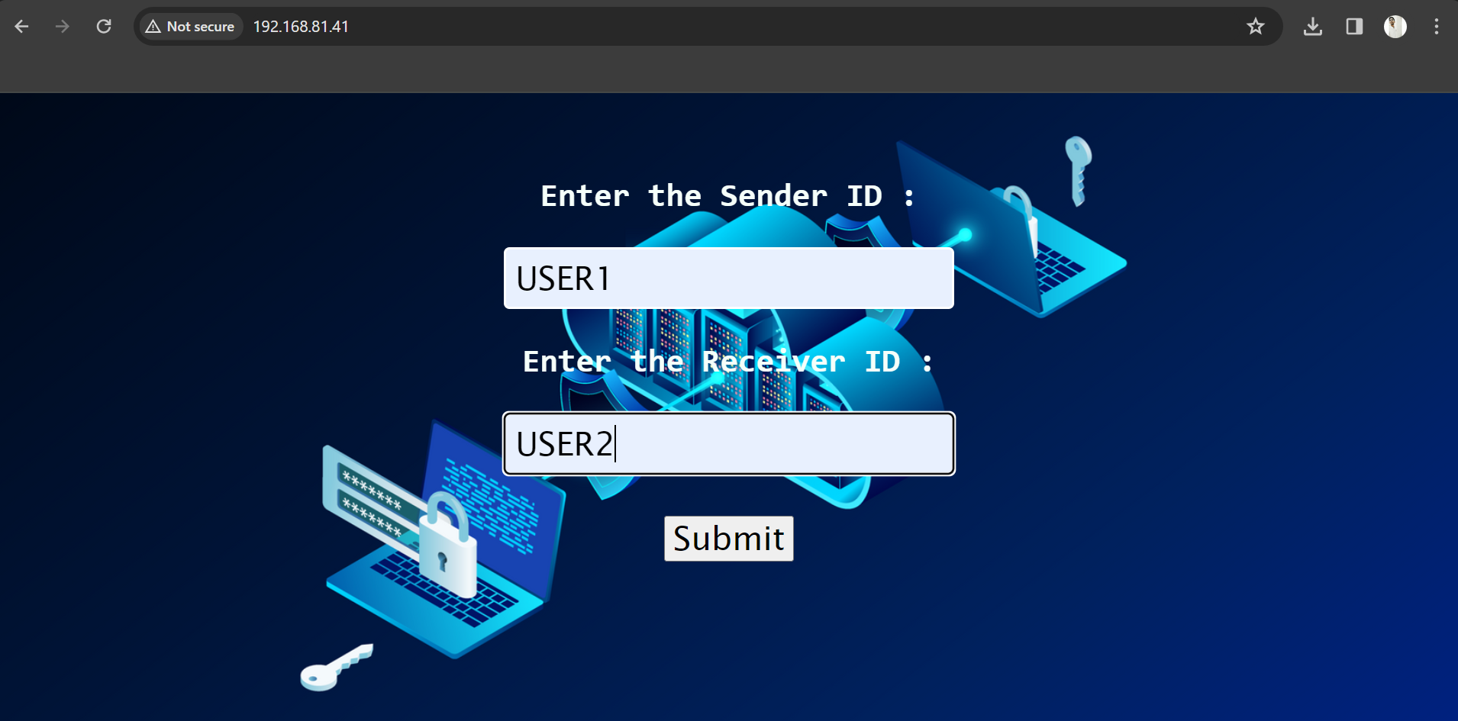
COLLECTING USER DATA

Slide 34
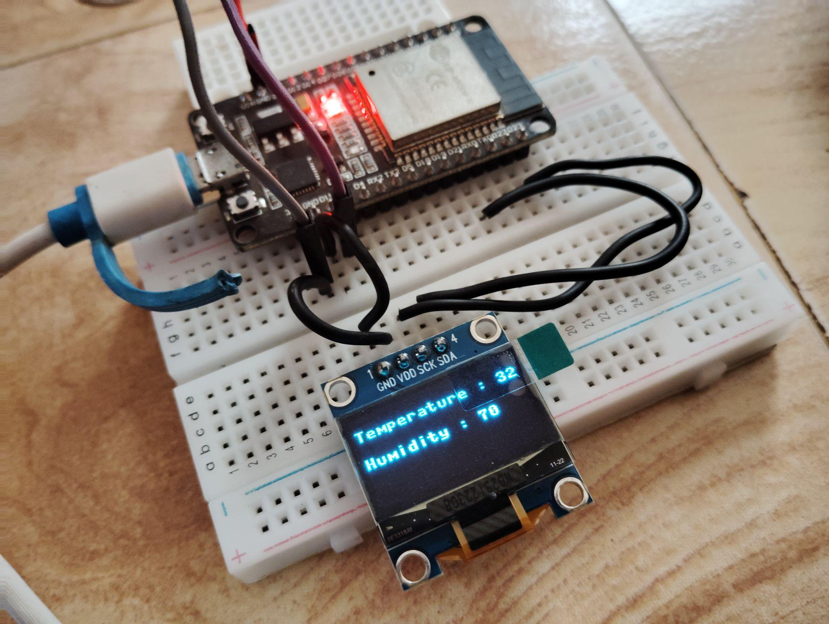
DISPLAYING SENSOR DATA

Slide 35
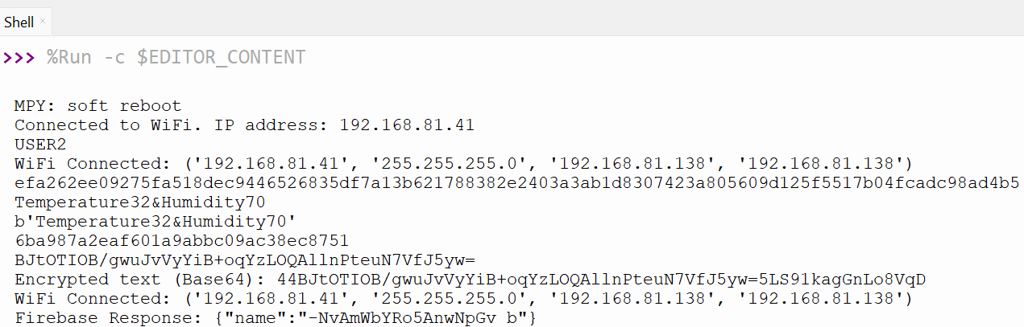
ENCRYPTING SENSOR DATA

Slide 36
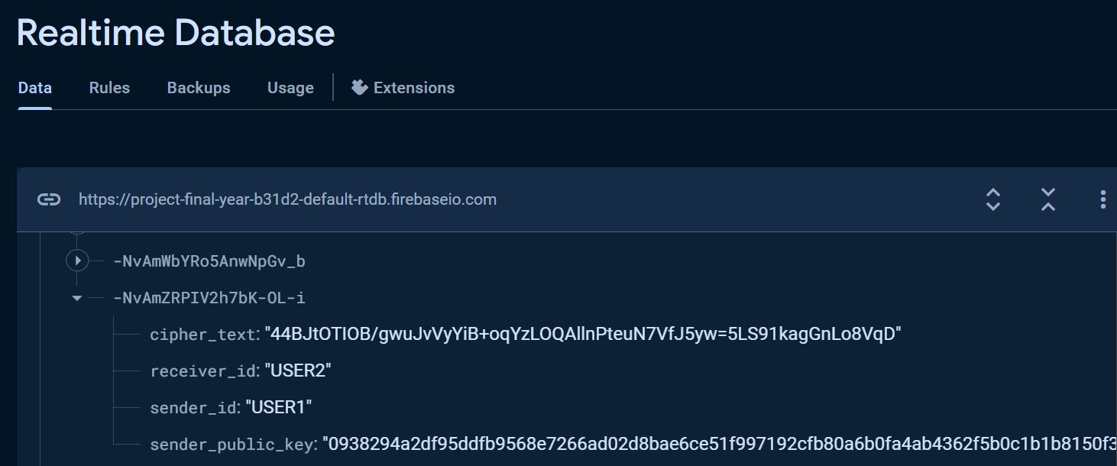
STORING DATA IN FIREBASE

Slide 37
SAMPLE INPUTS AND OUTPUTS RECEIVER SIDE

Slide 38

IP ADDRESS FROM TWILIO

Slide 39
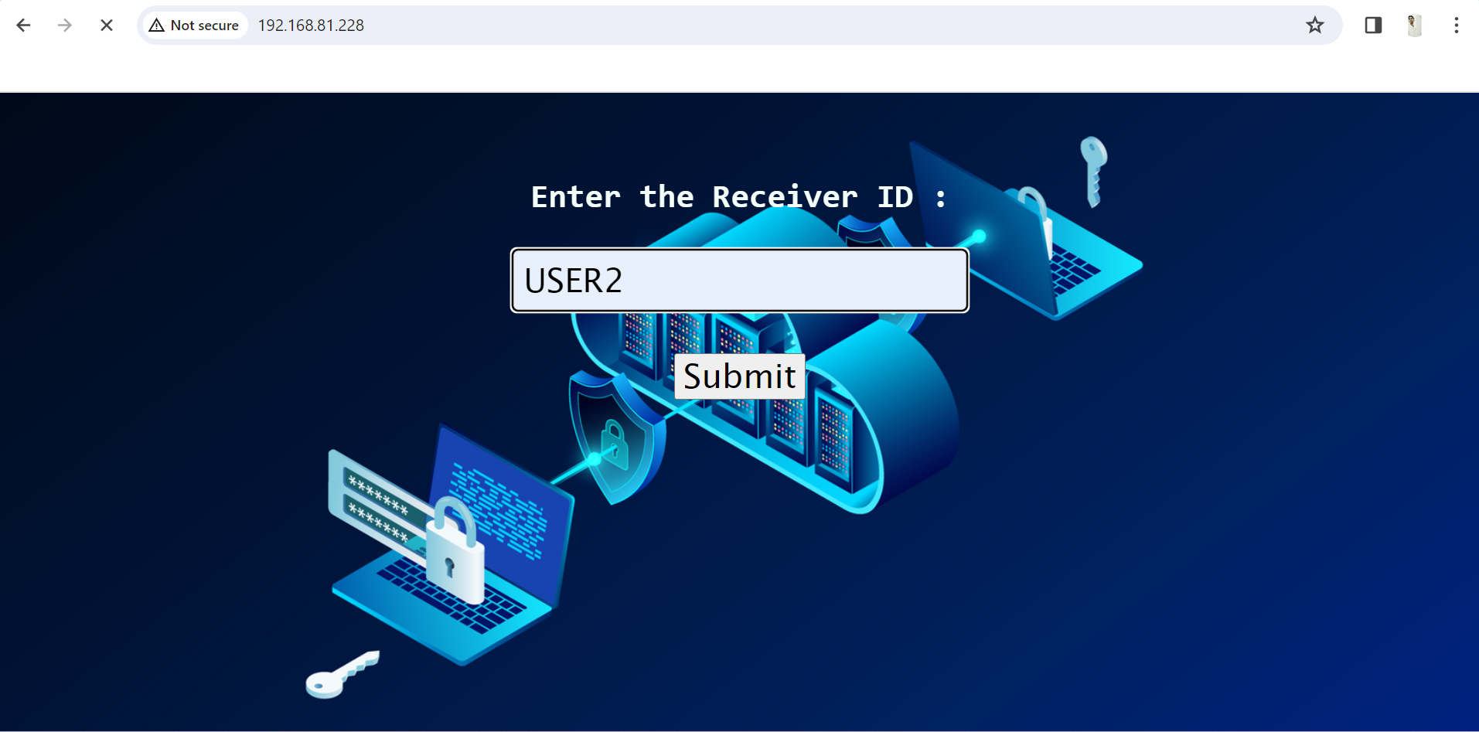
COLLECTING USER DATA

Slide 40
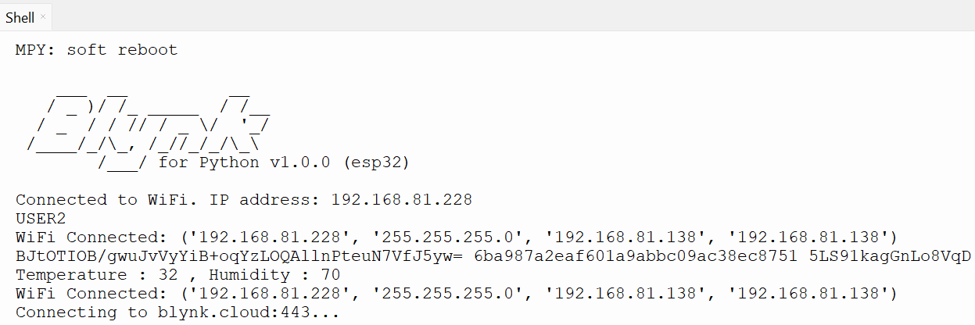
DECRYPTING SENSOR DATA

Slide 41
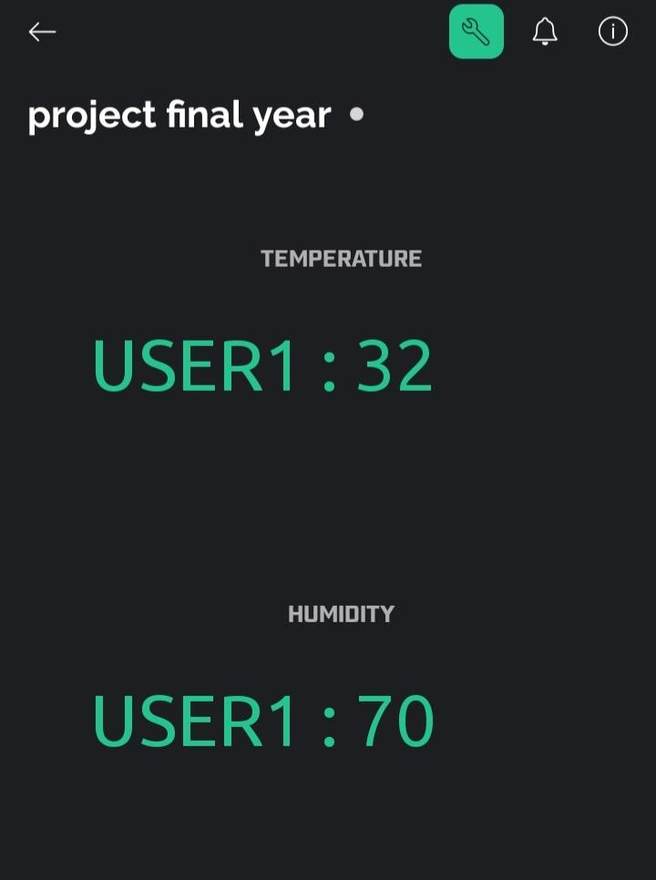
BLYNK IOT APP INTERFACE

Slide 42
PERFORMANCE METRICS
Run time :
Time taken to complete one successful encryption/decryption = 4 to 5 secs (approx) .
Storage :
Sender side : 340 kB
Receiver side : 392 kB
Power consumption :
Power consumption = 277.5 mW or 0.2775 W

Slide 43
PERFORMANCE METRICS
Security :
AES has undergone rigorous cryptanalysis over the years, and no practical attacks against the algorithm itself have been discovered.
The security of AES mainly dependent on its proper key exchange, which is achieved by using ECC as the key exchange algorithm.
Elliptic curve cryptography is based on the discrete logarithm problem, which is much harder to solve.

Slide 44
ADVANTAGES
Enhanced Security : By leveraging both ECC and AES, the hybrid algorithm provides a multi-layered security approach.
Resilience Against Cryptographic Attacks : Our hybrid algorithm provides security against various cryptographic attacks like Brute Force Attack, Differential Cryptanalysis, etc…..
Optimized Efficiency : ECC uses smaller key lengths for encryption than RSA, which uses a larger key length. For example, a 256-bit ECC key is considered as secure as a 3072-bit RSA key.
Lower Energy Consumption : By utilizing ECC for key generation and encryption, the hybrid algorithm reduces energy consumption during cryptographic operations.

Slide 45
APPLICATIONS
Securely Communicate: Our project facilitates secure communication channels, ensuring confidentiality, integrity, and authenticity of data transfer.
Personal Medical Data: It enables the safe exchange of sensitive personal medical data, adhering to privacy regulations and ensuring patient confidentiality.
Military Applications: Our solution supports the transmission of location coordinates in military applications, enhancing operational security and mission effectiveness.
Industrial IoT: It fosters communication between industrial sensors, actuators, and control systems, optimizing automation processes and ensuring data integrity in industrial environments.

Slide 46
CONCLUSION
By combining the strengths of symmetric and asymmetric encryption algorithms, hybrid cryptography provides a balanced approach that ensures both efficiency and confidentiality in data transmission and storage within IoT ecosystems

Slide 47
REFERENCES
1. Dr.M.Tanooj kumar, Revanth Kumar Katragadda, Vishnu Srujan Kolli and Shaik Lahir Rahiman, “A Hybrid Approach for Enhancing Security In Internet of Things (IoT)”,in International Conference on Intelligent Sustainable Systems (ICISS), 2019, Department of Computer Science and Engineering, Koneru Lakshmaiah Education Foundation, Vaddeswaram, Guntur, Andhra Pradesh, pp. 110-114, 2019.
2. Nilupulee A. Gunathilake, William J. Buchanan and Rameez Asif ”Next Generation Lightweight Cryptography for Smart IoT Devices”, in IEEE 5th World Forum on Internet of Things (WF-IoT), pp. 707-710, 2019.
3. Meryam Saad Fadhil, Alaa Kadhim Farhan, Mohammed Natiq Fadhil, Nadia M. G.Al-Saidi “A New Lightweight AES Using a Combination of Chaotic Systems” on 1st International Conference of Information Technology to enhance E-learning and other Application, (IT-ELA 2020), Baghdad College of Economic Sciences University, Baghdad, Iraq, pp. 82-88, 2020.

Slide 48
REFERENCES
4. Mohammed Aledhari, Ali Dehghantanha, Kim-Kwang Raymond Choo “A Hybrid RSA Algorithm in Support of IoT Greenhouse Applications” on 2019 IEEE International conference on Industrial Internet(ICII), pp. 233-240, 2019.
5. A. Raya and k. Mariyappn, ”Security and Performance of Elliptic Curve Cryptography in Resource-limited Environments: A comparative Study”,on 20 15th International Conference on Internet Technology and Secured Transactions (ICITST), pp. 1-8, 2020.
6. B. T. Asare, K. Quist-Aphetsi and L. Nana, "A Hybrid Lightweight Cryptographic Scheme For Securing Node Data Based On The Feistel Cipher And MD5 Hash Algorithm In A Local IoT Network" 2019 International Conference on Mechatronics, Remote Sensing, Information Systems and Industrial Information Technologies (ICMRSISIIT), pp. 1-5, 2019.

Slide 49
REFERENCES
7. J. Kaur, S. Lamba and P. Saini, "Advanced Encryption Standard: Attacks and Current Research Trends," 2021 International Conference on Advance Computing and Innovative Technologies in Engineering (ICACITE), pp. 112-116, 2021.5.
8. J. Zhao, "DES-Co-RSA: A Hybrid Encryption Algorithm Based on DES and RSA" 2023 IEEE 3rd International Conference on Power, Electronics and Computer Applications (ICPECA), pp. 846-850, 2023.

Slide 50
THANK YOU...

